Slide 1
Choroidal Neovascular
PO Lindara

Slide 2
Outline
Overview
Epidemiology
Investigation
Treatment
Discussion
Referrence

Slide 3
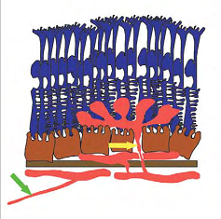
Overview
Proliferation of fibrovascular lesions from choriocapillaries through defects in Bruch’s membrane into subretinal space
Cause:
Degenerative (AMD, High myopia, IPCV,...)
Inflammation
Trauma (rupture, laser...)
Tumor
Idiopathic
Could be:
Classic
Occult
Mix

Slide 4
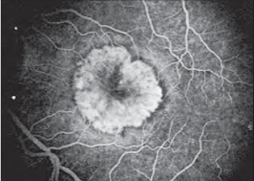
Investigation
FFA: MPS; early in the course
Classic:
Extrafoveal (>200 μm from fovea/FAZ)
Juxtafoveal (<200 μm from fovea/FAZ)
Subfoveal
Occult:
Fibrovascular PED, slower than classic
Late leakage of undetermined source (2-5 min after injection)
ICG: hot spot or plaque
OCT: monitoring the respond of the treatment

Slide 5
Treatment
Laser:
Photocogulation
Photodynamic (Verteporfin; Visudyne...)
Antiangiogenesis:
Pegaptanip (Macugen)
Ranibizumap (Lucentis)
Bevacizumab (Avastin)
Aflibercept (Eylea)
Combination
Surgery

Slide 6
Discusion
MPS:
Laser is beneficial in all type of classic CNV
But SVL occur in both treated and untreated
Risk of immediate visual lose after treatment
TAP:
Benefit in smaller minimally lesions (<4 MPS)
VIP:
Greatest benefit for eye with occult CNV without a classic component, < 4 disc area, VA < 20/50
Should not treated, >4 disc area, VA > 20/50

Slide 7
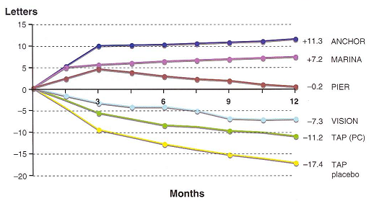
Discusion
VISION: (Macugen)
Safe: less widespread than other anti-VEGF
70% loss < 3 lines and 10% loss > 3 lines VS 55% and 22% at 1 months
gain > 3 line 6% VS 2% of control patient at 1 year
MARINA and ANCHOR: (Lucentis)
95% improve or stable VS 62% sham after 12months
95% improve or stable VS 64% PDT after 12 months

Slide 8
Discussion
Aflibercept (Eylea):
Maintain and Improve VA compare to the other
beneficial in a subset of patients with neovascular age-related macular degeneration who exhibit recurrent or resistant intraretinal or subretinal fluid following multiple injections with either bevacizumab or ranibizumab.
Improve VA and anatomically

Slide 9
Efficacy and Safety in with intravitreal aflibercept achieved visual acuity and anatomic improvements similar to individuals managed with monthly ranibizumab while receiving an average of five fewer injections during the first 12 months of treatment

Slide 10
Conclusion
Well explanation before start treatment.
Goal of treatment to stable or slow progression Visual lose
Risk of fellow eye, subsequent CNV scaring, Low vision
Quality of life
Availability of patient and physician

Slide 11
Thank you

